Slide 1
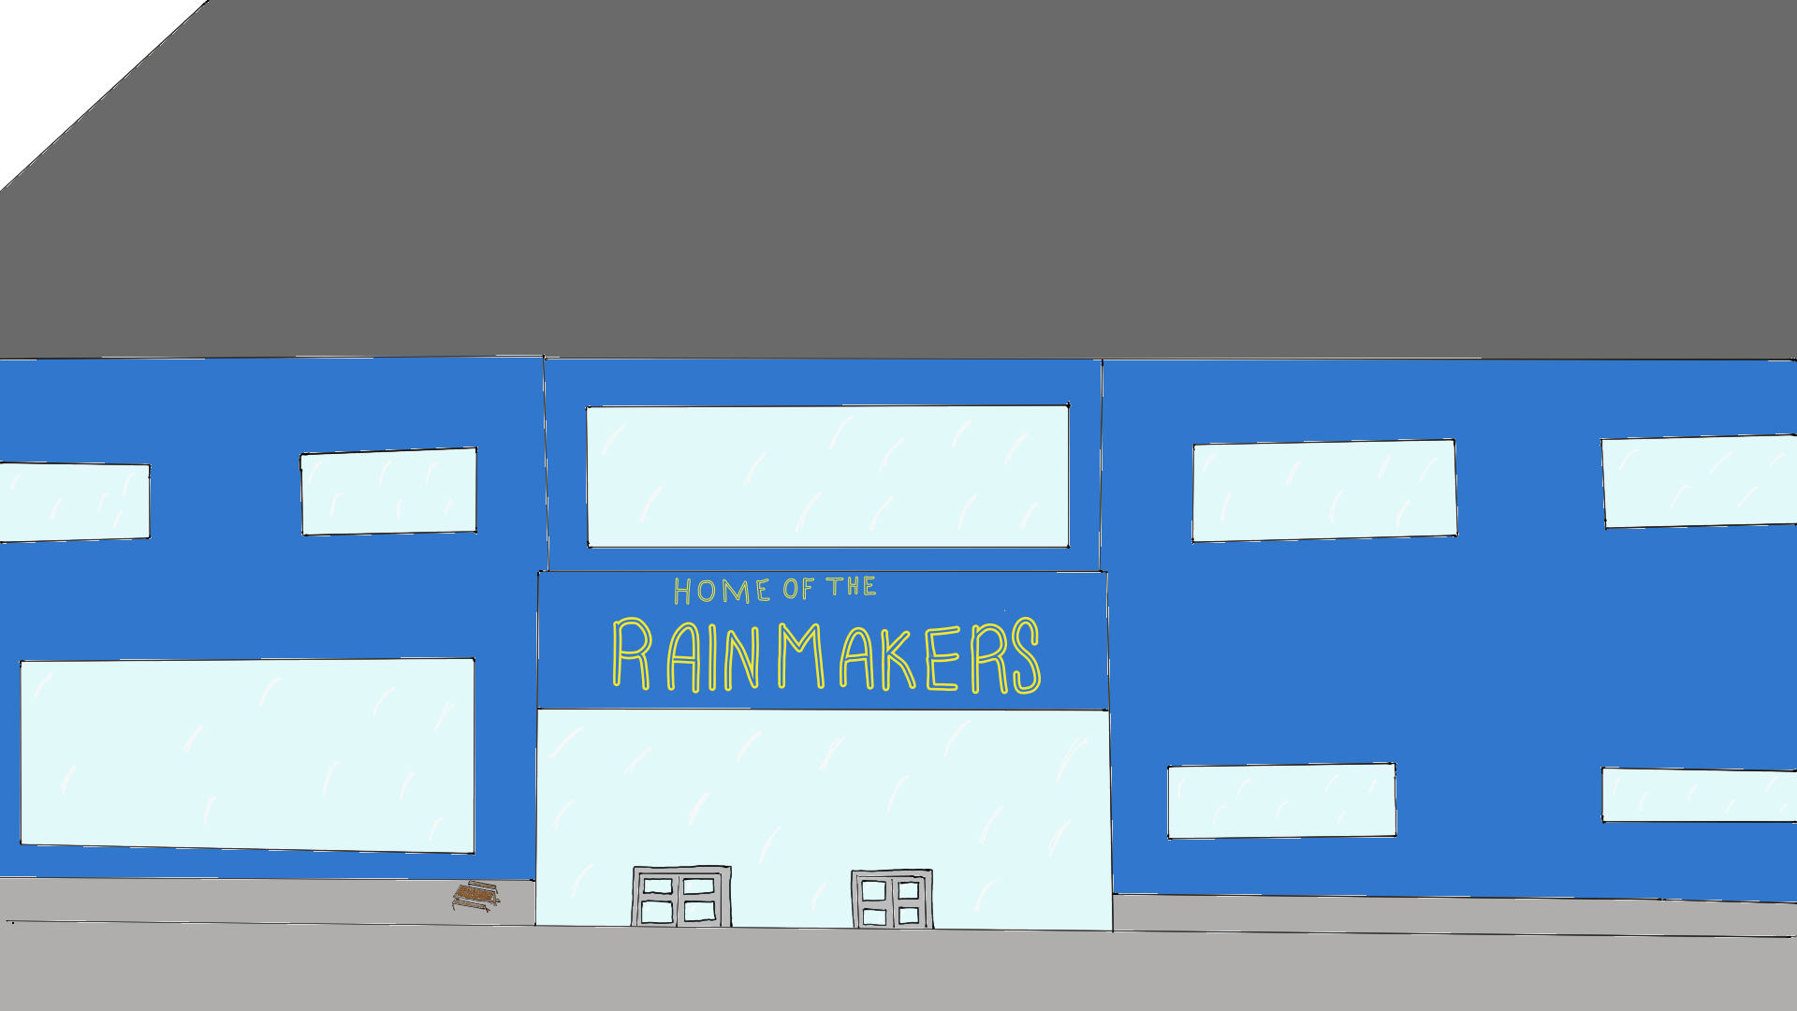
Krista Robinson
Visioning Project
EDUC 393
Melanie Raymond
November 27, 2025
On the unceded territory of the Ts'msyen and Sm'algyax speaking peoples.

Slide 2
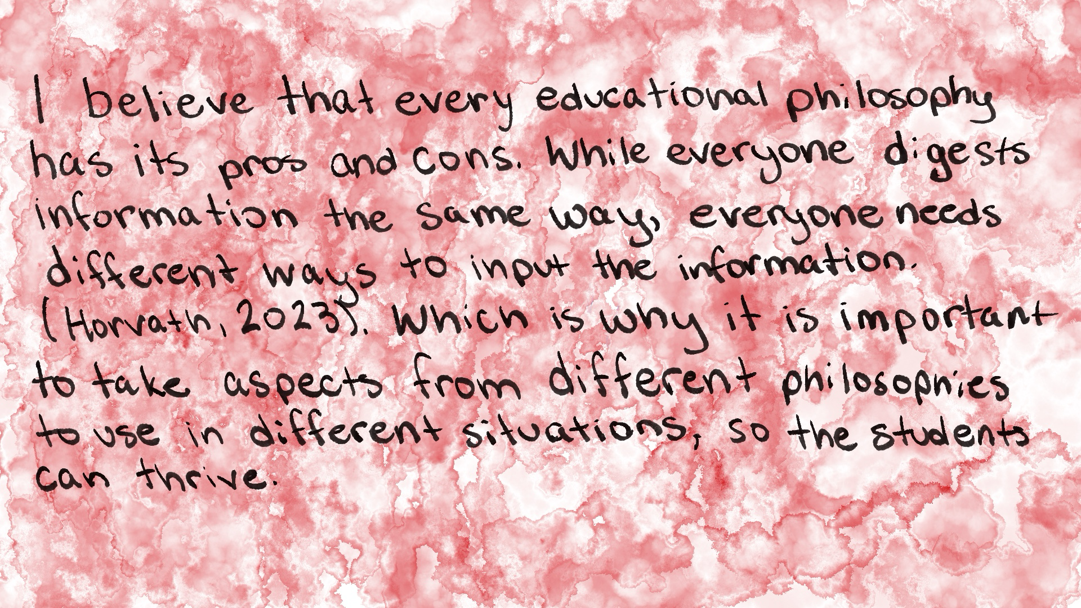

Slide 3
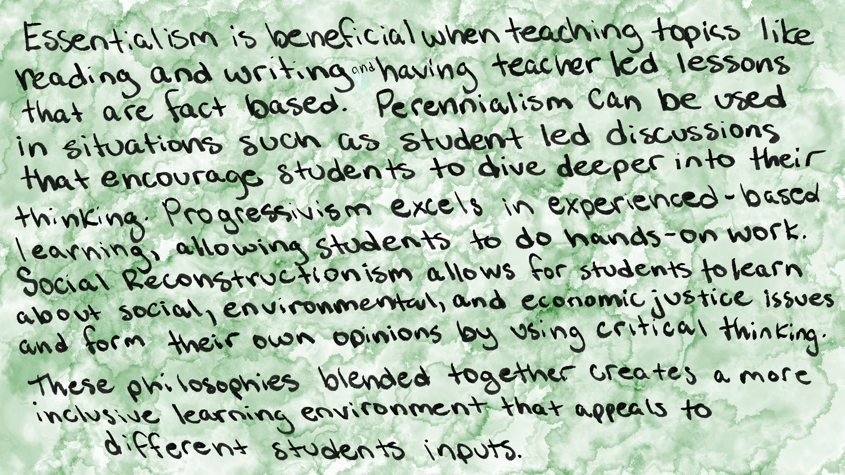
(Raymond, 2025)

Slide 4
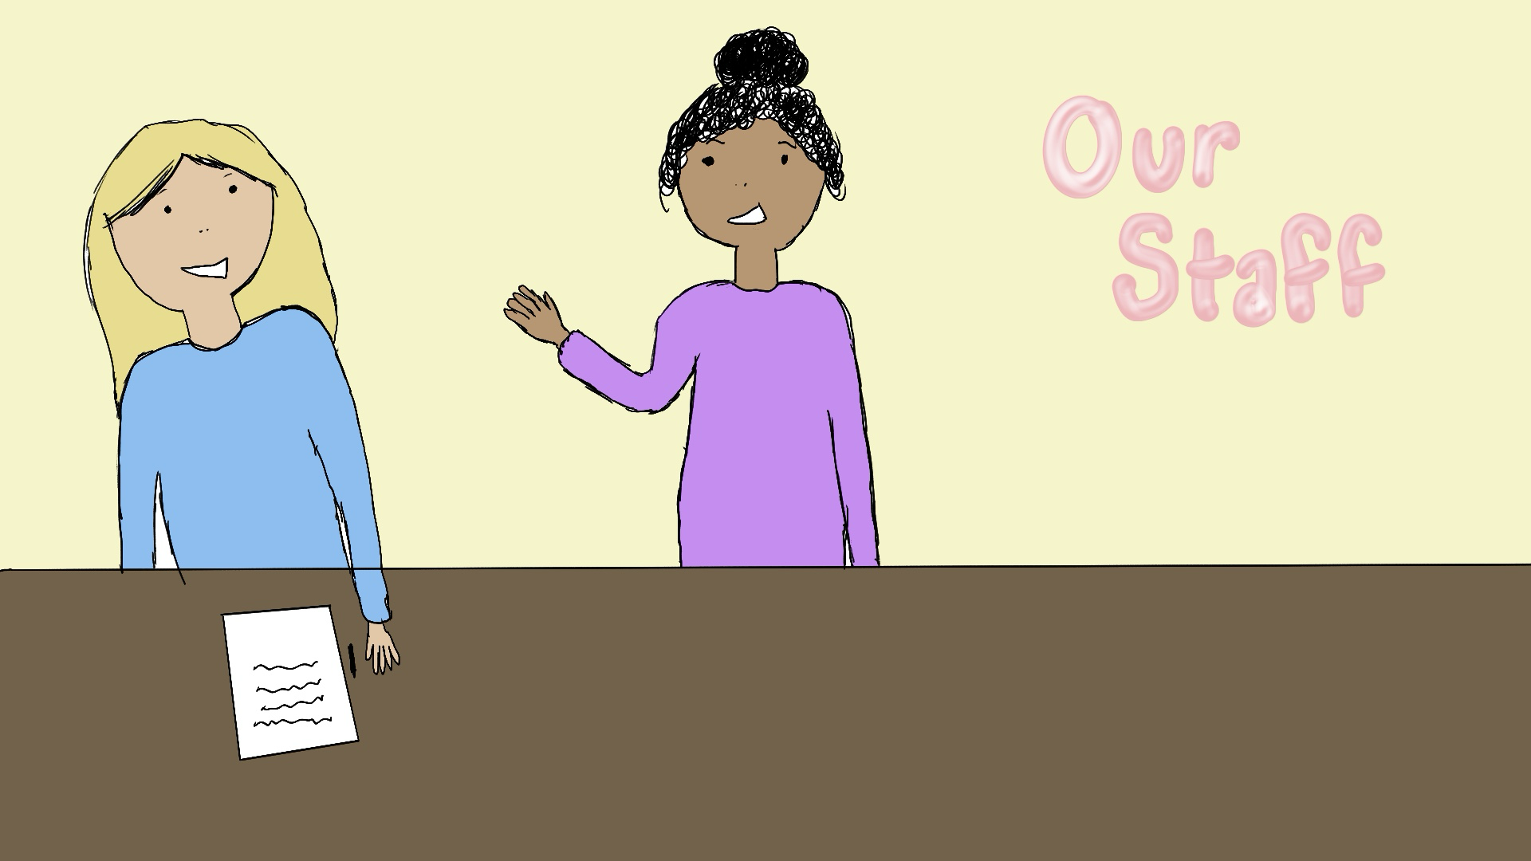
Each morning our staff have a quick 10–15 minute morning meeting check in. This allows our staff to share their plans for the day and ask for any support they may need. We also have a calendar for snack days and always have the coffee on!
We have a collab period every Wednesday, it’s an hour at the end of the day where students get out early. Grade group staff get together to collaborate with each other.

Slide 5
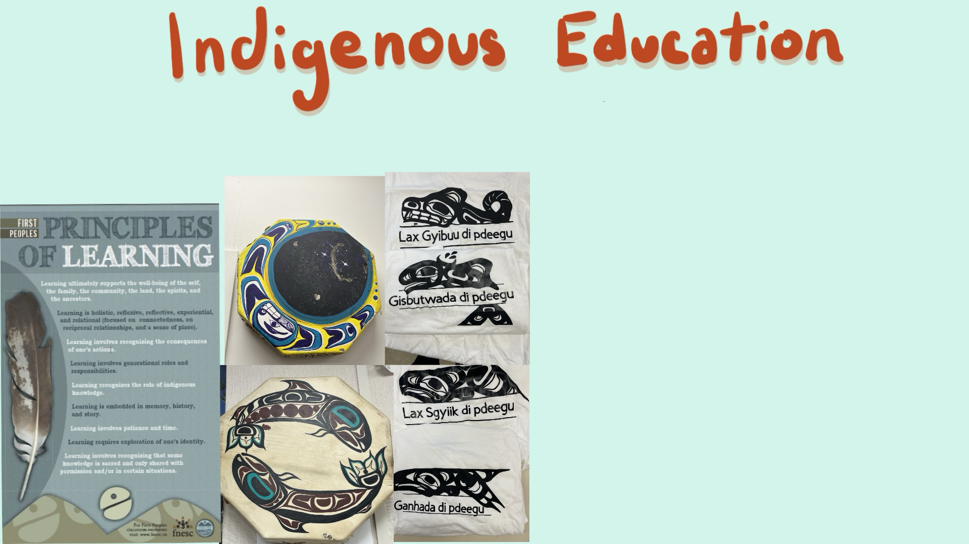
Indigenous Education is used cross-curricular in our school. Our staff incorporates First Peoples Principles of Learning into every subject. Every student learns Sm'algyax, whether it be from second language class or from English First Peoples where the language is incorporated into the course. We work with Elders often in our school and invite artists and carvers to come into classrooms to work with our students. Classes often participate in community activities such as All Native Basketball tournament and Indigenous Day events.
Artwork by Lucy Trimble

Slide 6
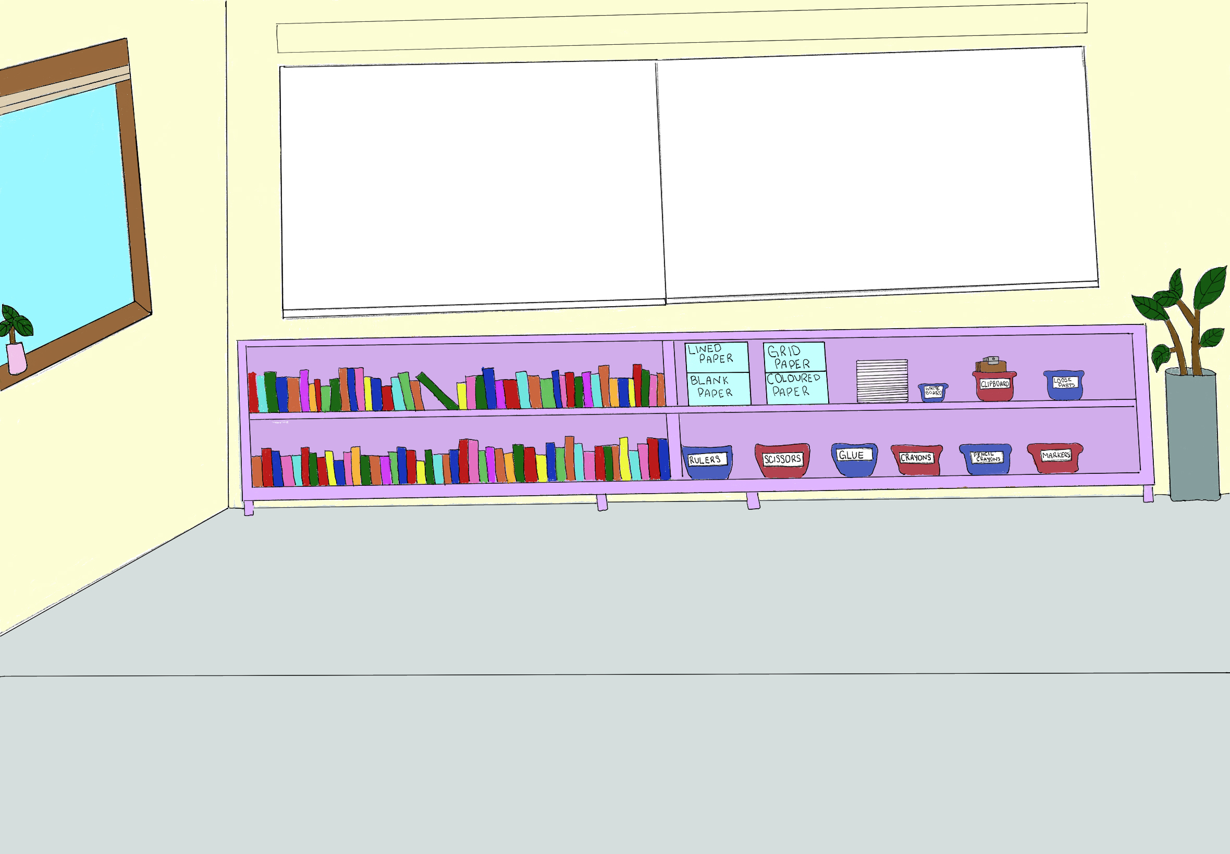
Having a variety of books for students to read, all different levels. Having class sets of supplies such as rulers, scissors, glue markers and crayons. As well as an abundance of different types of paper. Class set of clipboards and whiteboards to use in different activities. Plenty of whiteboard space to use as visuals for students.
Bright coloured classroom with plenty of natural lightning opposed to florescent lighting. Plants around the classroom.
(Sachdeva, Hewitt, 2025).

Slide 7
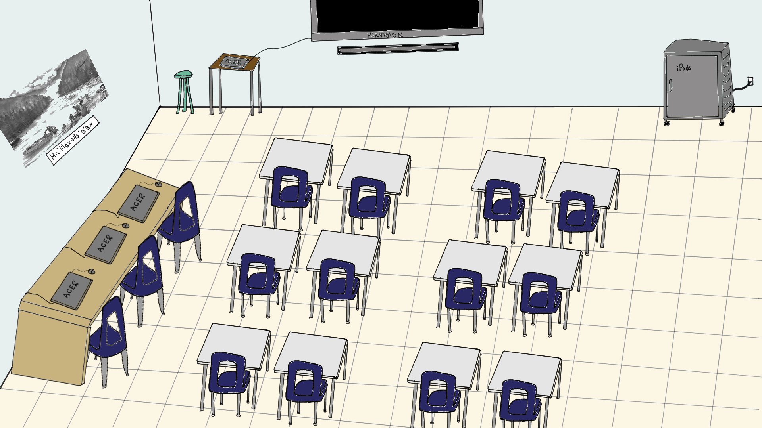
Technology
Laptop station in classroom.
Hikvision- with a sound bar.
iPad cart.
Desks or tables. Cubbies for students to put their belongings in rather than inside a desk.

Slide 8
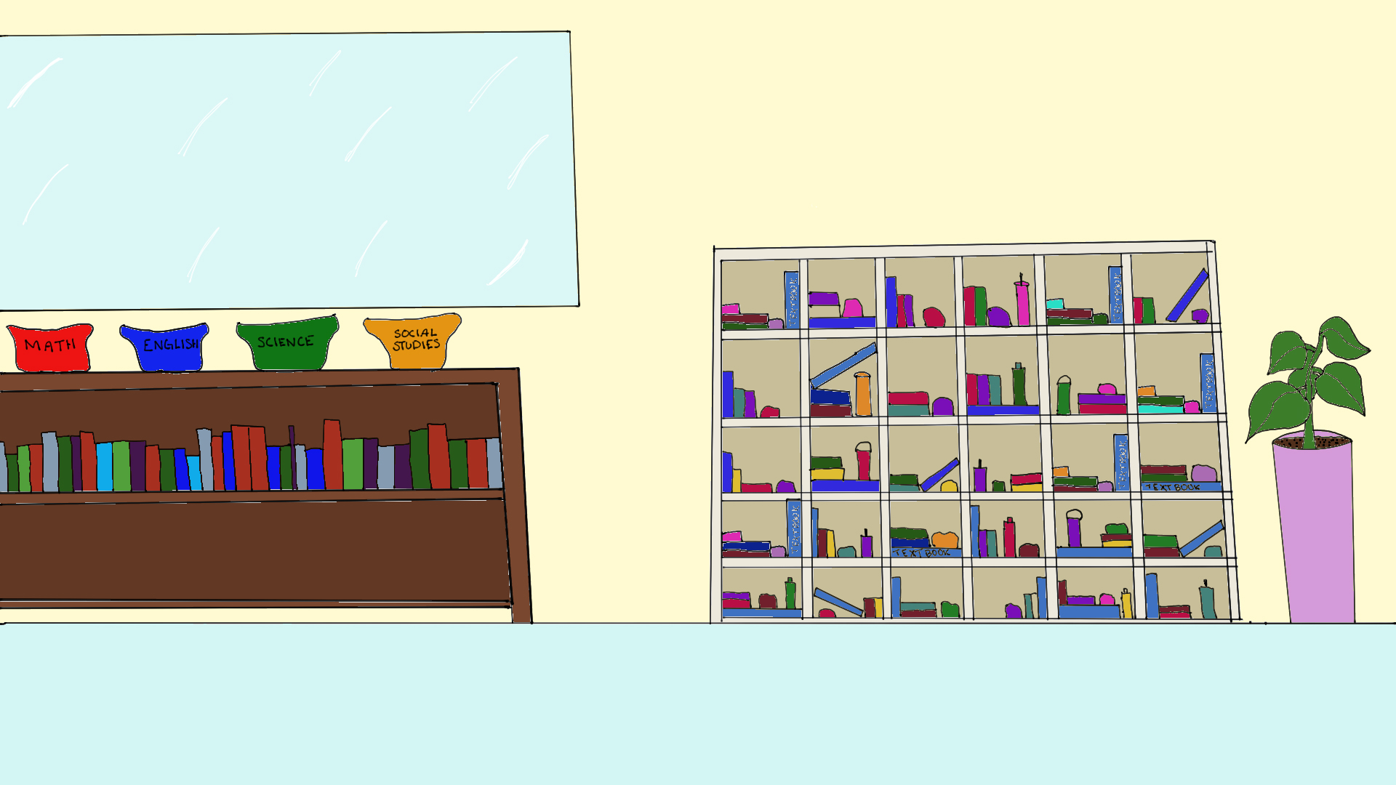
This prevents
Messy desks
Food in desks
Distractions from stuff inside desks.
Specific places for duo-tangs. Each class has a specific-coloured duo-tang.

Slide 9
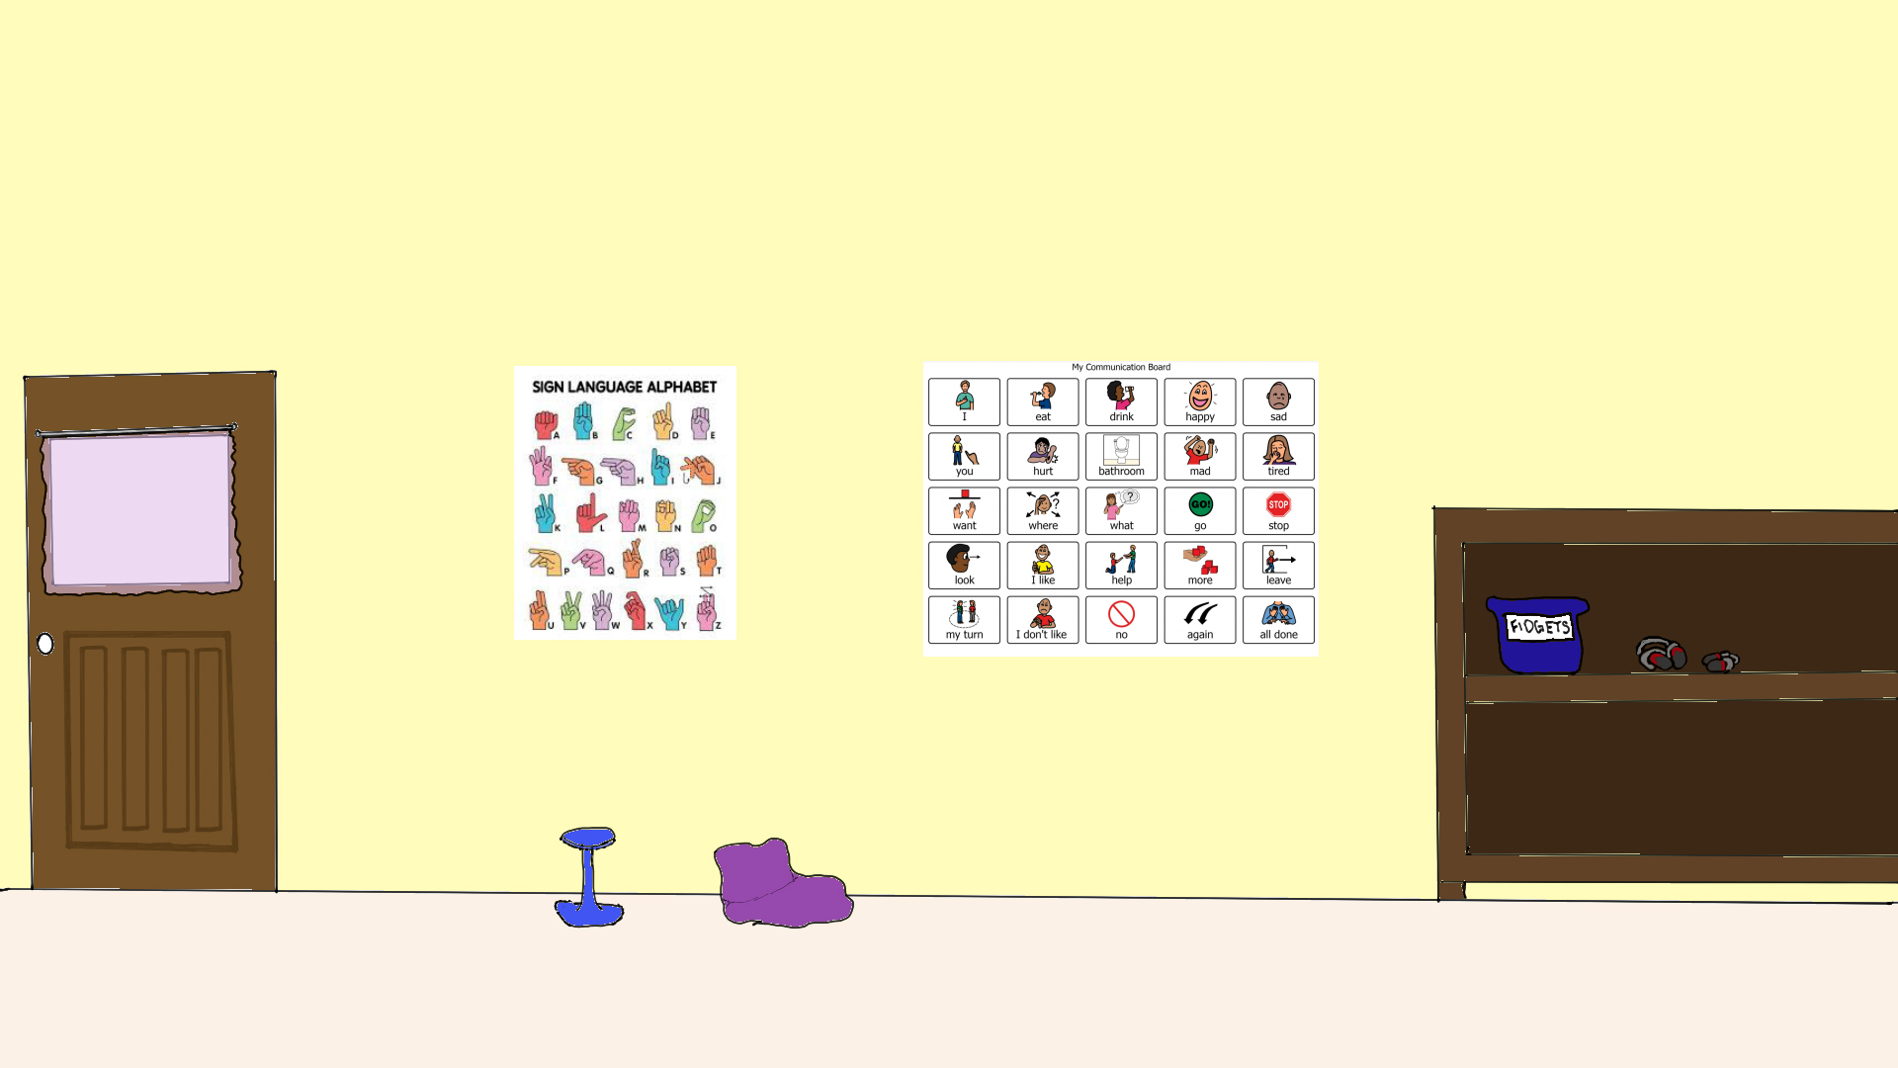
Accessibility and Inclusion
School is a place for everyone, and everyone deserves to feel welcomed and that they can communicate. There is a sign language alphabet in every classroom with daily mini lessons on sign language and a communication chart for those who struggle with oral communication.
Fidgets and noise canceling headphones for those who feel over stimulated from loud noises.
Sensory rooms
Different types of seating
Accessible water fountains for wheelchair uses
  Motion sensor water fountains for those who struggle with motor functions.

Slide 10
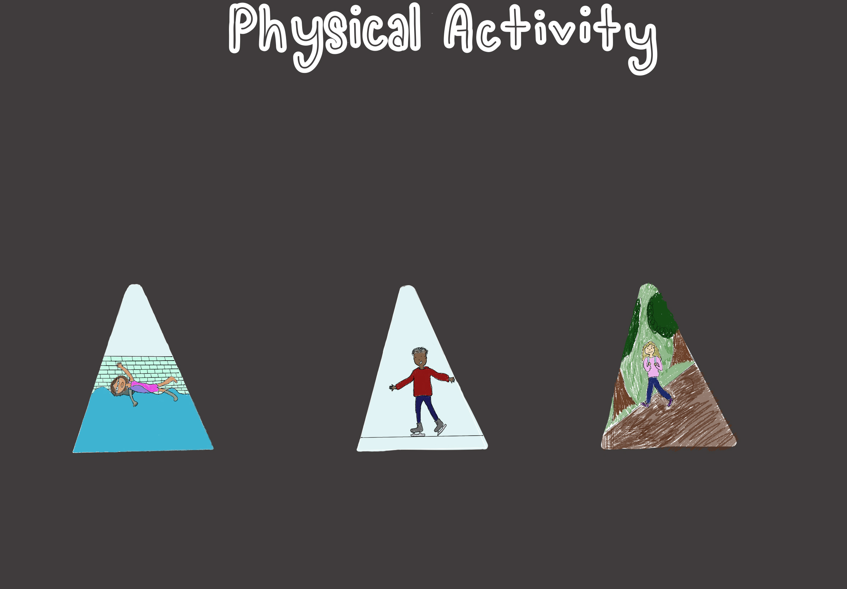
Ensuring students have physical activity everyday. Some days this may include P.E class, on other days there will be a DPA (Daily Physical Activity) block. During this block classes can go for walks, play games in the gym, do workout circuits in classroom, etc.
Special physical activities include things such as swimming, skating, kayaking, etc. These can be things that happen a couple times a year, getting students to experience things that they might not do on their own with the hopes that they might enjoy it and continue to do it after school.

Slide 11
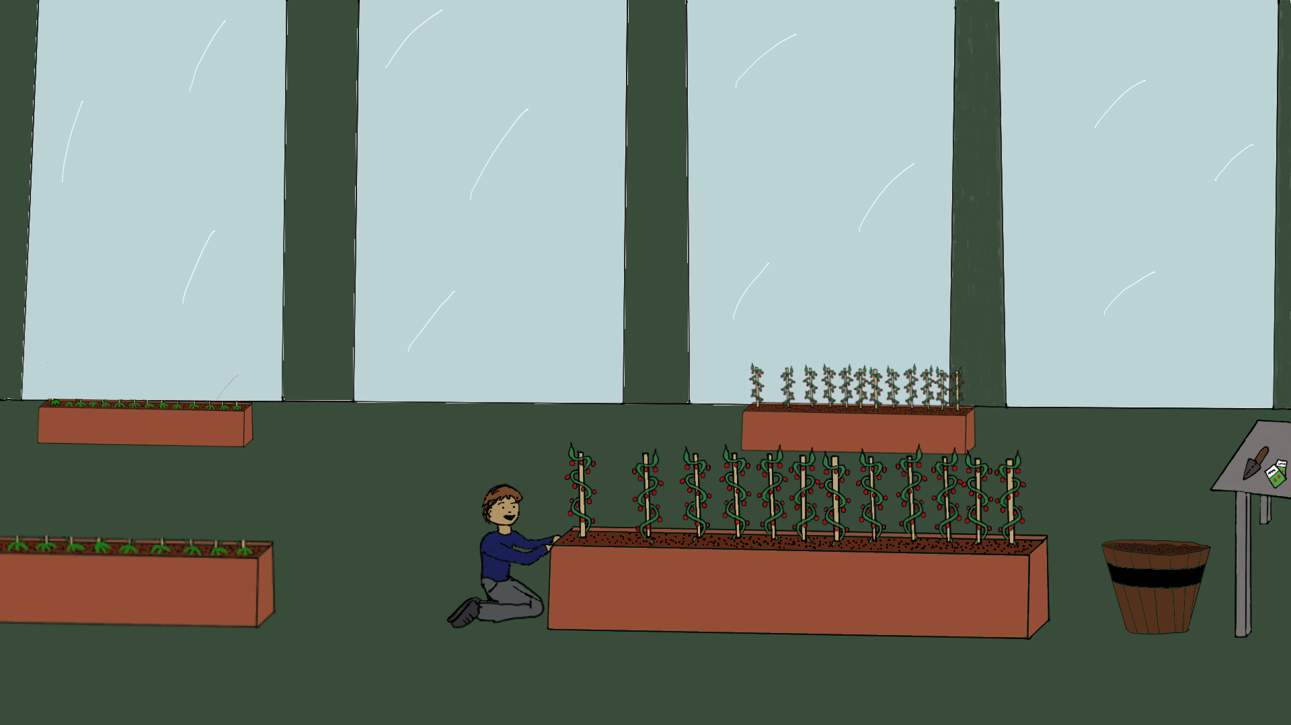
Outdoor Education
Helps with hands-on and experiential learning
Learning from the land
  Walking with nature and getting out of the classroom.
Opportunities to invite Elders
Helps build respect for the environment
Can be used in geography -> reading maps -> compasses.
Greenhouse learning
  Teaching about plants, harvesting and traditional uses.
  Can be used in cross-curricular (Science, Math, etc.)
(Donald, 2021)

Slide 12
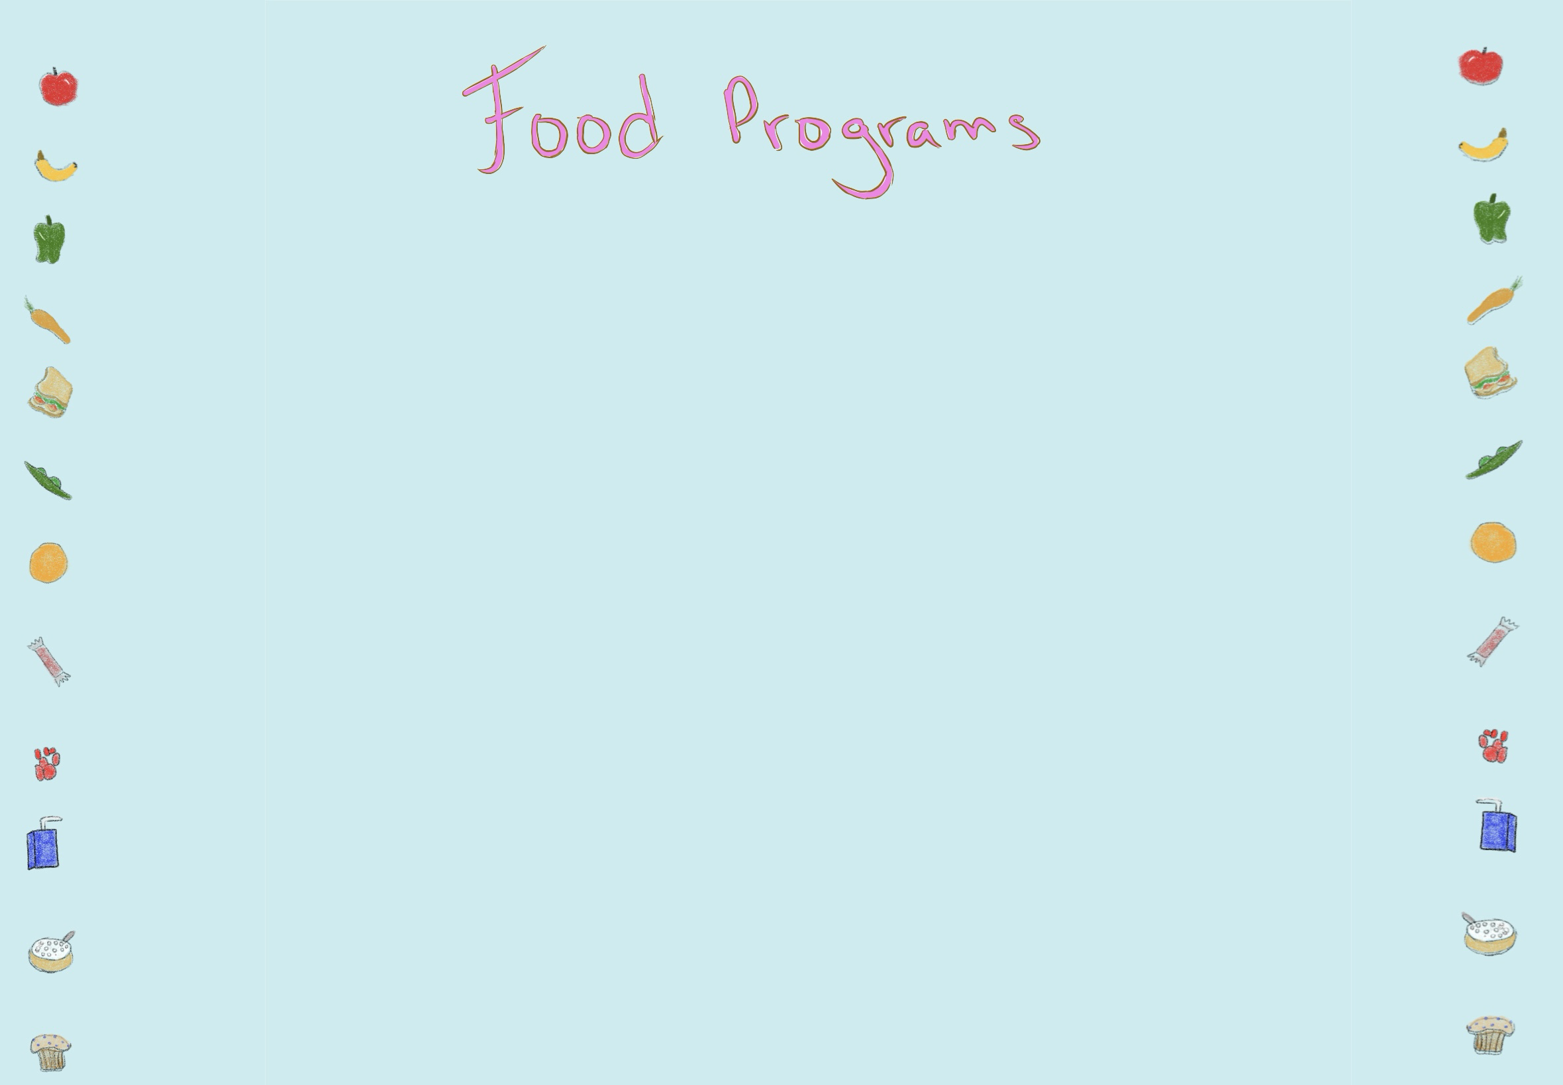
Having a food program within a school is so important. Starting the day ensuring that students who need food have access to it. Having a comfortable room in which students can sit with their friends, or by themselves, and have some variety of food to eat. Having even a small selection of hot breakfast, such as oatmeal or boiled eggs, and cold breakfast options like cereal.
Similar with the lunch program that has balanced lunches for students who need lunch food.
(Raymond, 2025)

Slide 13
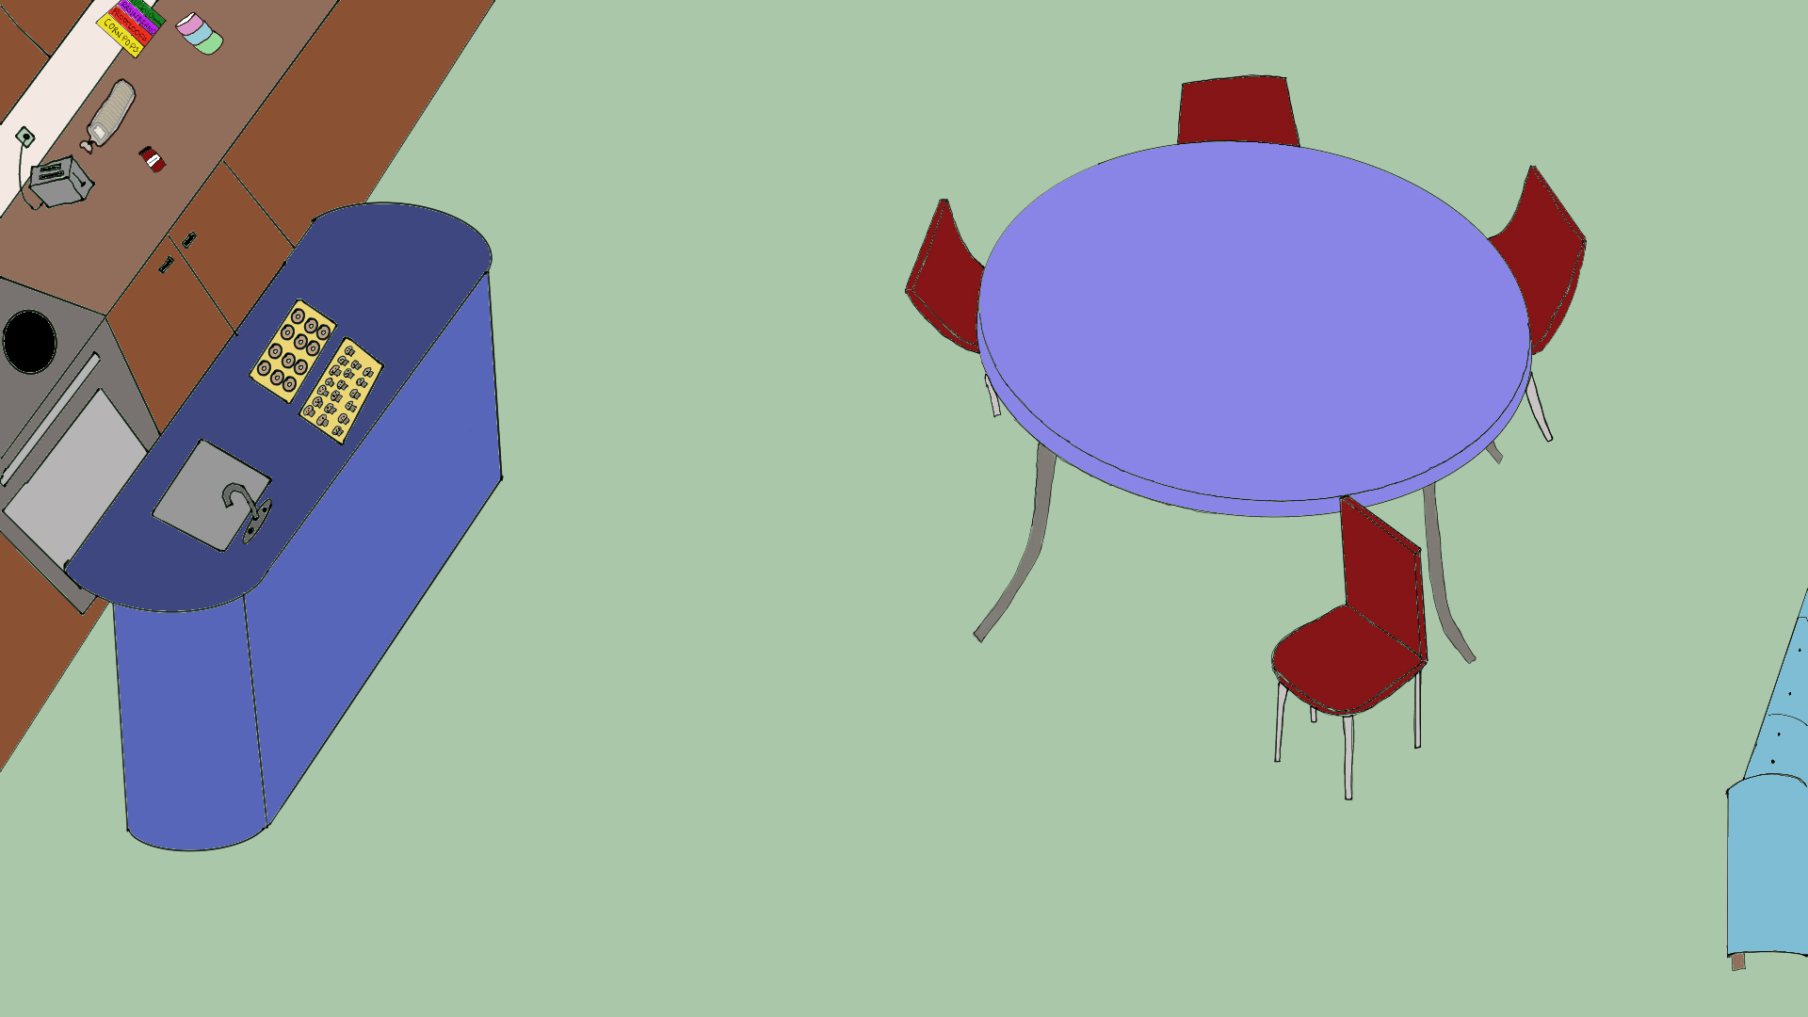

Slide 14
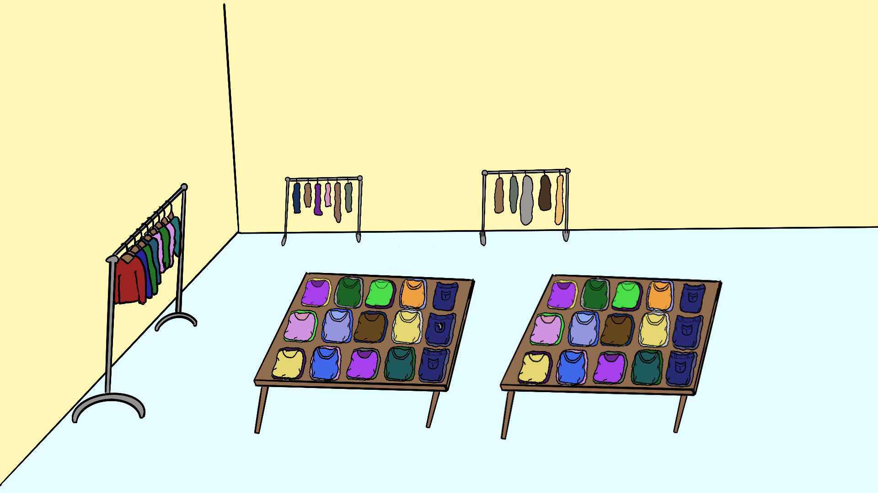
The idea of the clothing program comes from PRMS. An EA, Arlene McMillian, took it upon herself to do a “Clothing Drive” for middle school students.
Twice a year
Community Donations
Clothing Walk
In our school, there is a small room that is dedicated to this idea all year round, with the two bigger clothing events that happen seasonally.
(Agarwal, 2025)

Slide 15
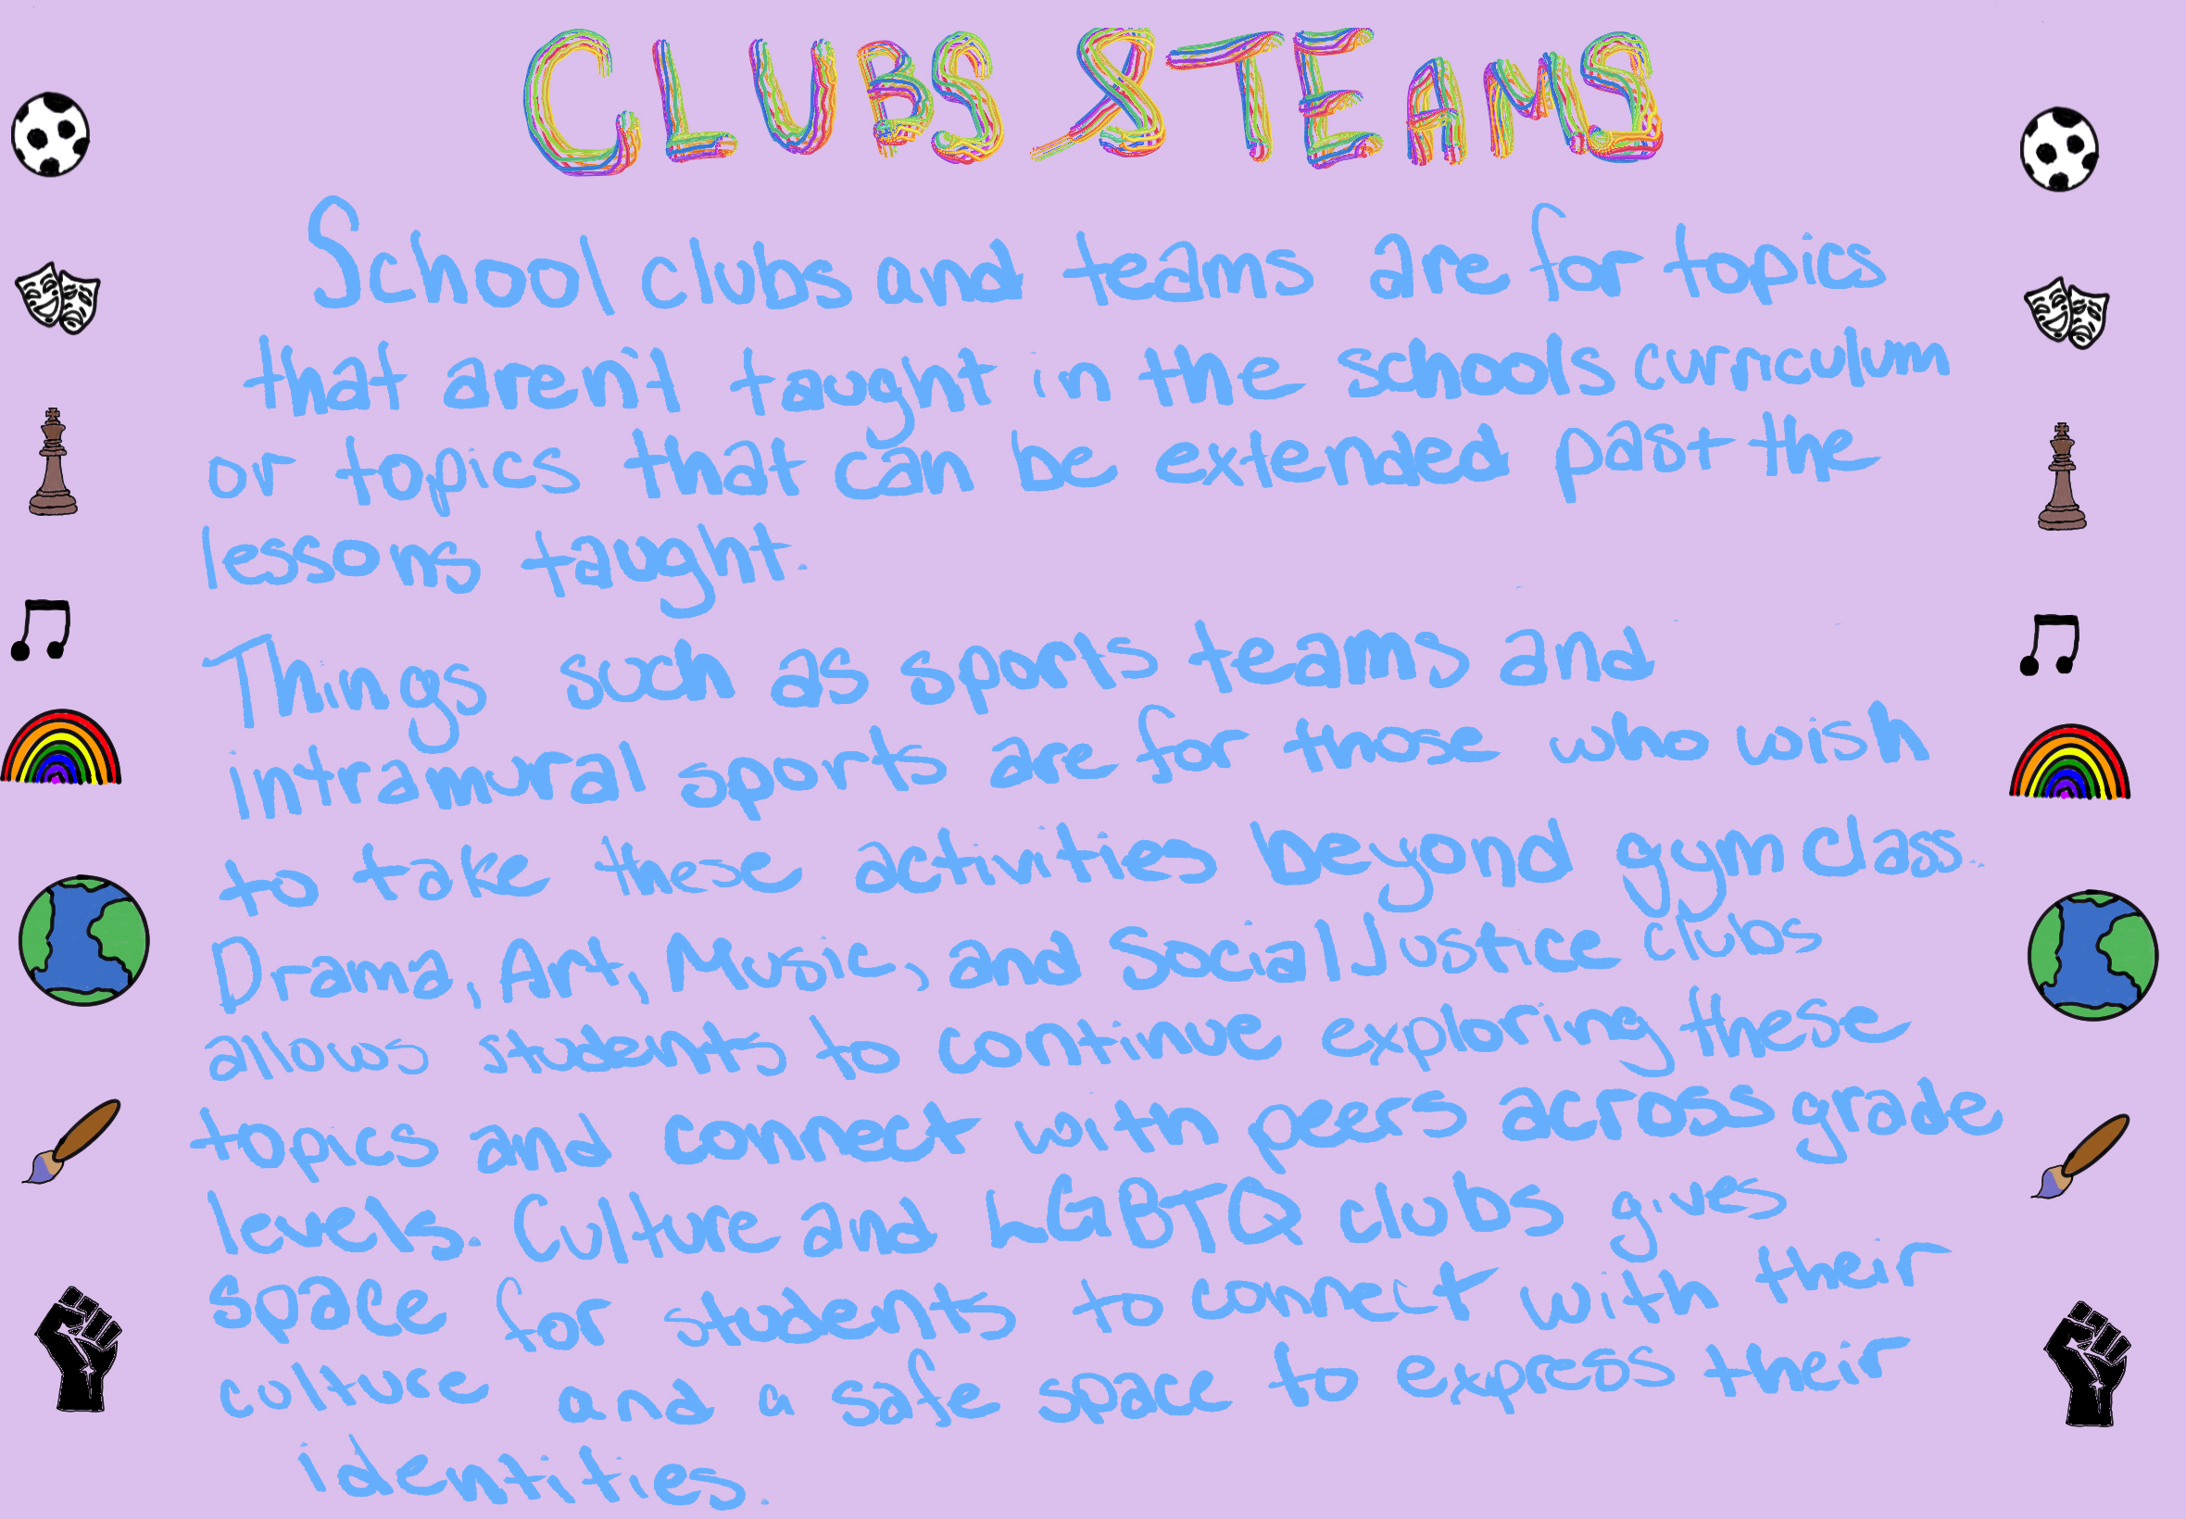

Slide 16

Using books more often in lessons has many benefits.
Learning is embedded in story
Can be used cross curricular
  Any age can listen to a story
Gives background knowledge
Builds upon vocabulary
(Lyon, 2025)

Slide 17

Theatre/Auditorium.
Drama
  Plays/Musicals/Fine Arts Showcase
Assemblies
  Comfortably holds the whole school
Movies
  All grades/grade group/family night
Performances

Slide 18
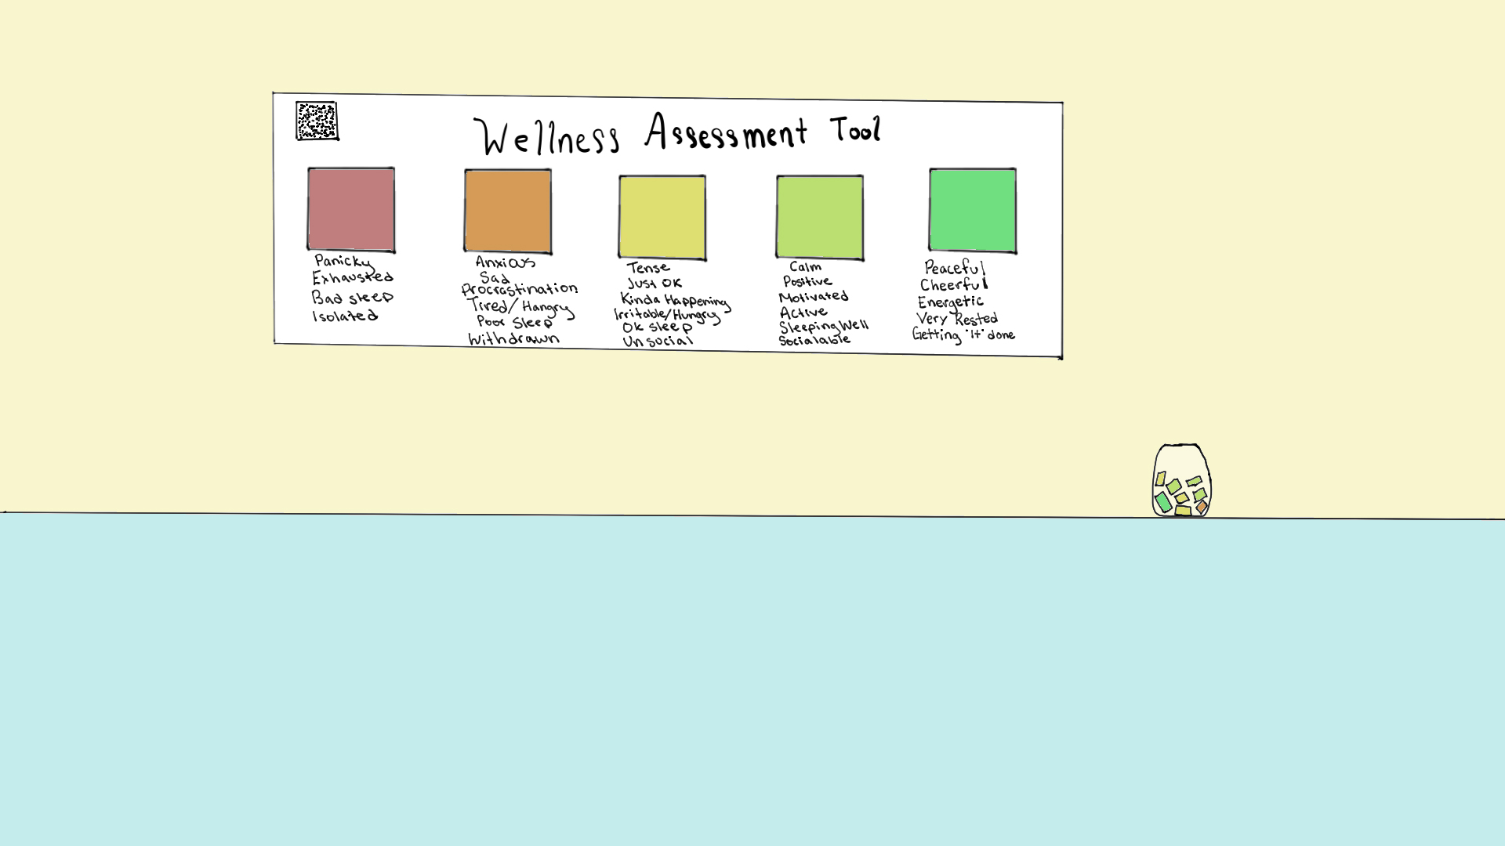
The Wellness Assessment Tool is a daily check in for the students to use to let their teacher know where they are that day. This can be anonymous, or they can add their name. In the younger grades it can be used as a paper system where they put the colour of paper they resonate with in a jar.
For older grades there is a QR code they can use their devices to scan, and it will take them to a site where they can choose where they are at that day with a space to add any comments for the teacher.

Slide 19


Slide 20

References
Agarwal, Radha. (2025, April 25.) Prince Rupert Middle School seeks donations for Annual Spring Clothing Walk. The Northern View.
  https://thenorthernview.com/2025/04/25/prince-rupert-middle-school-seeks-donations-for-annual-spring-clothing-walk/
Donald, D. (2021). We need a new story: Walking and the Wâhkôhtowin Imagination. Journal of
the Canadian Association for Curriculum Studies, 18(2), 57–58.
Jared Cooney Horvath. (2023, December 19). All People Learn The Same Way: The Most Unnecessarily Controversial Statement [Video]. YouTube.
  https://www.youtube.com/watch?v=NIO08oUNPUo
Lyon, K. (2025) Building Background Knowledge and Vocabulary [Slides]. Canva
https://www.canva.com/design/DAG11R4E5hA/MHIbhnmza3DlHKmXc-0ewA/edit
Sachdeva, N. Hewitt, J. (2025, August 13.) The Transient Information Effect: Why Great Explanations Don’t Always Stick. The Science of Learning.
  https://scienceoflearning.substack.com/p/the-transient-information-effect
Raymond, M. (2025). Key Philosophical Terms & Concepts from Western Philosophy [Canva slides]. Moodle. https://moodle.unbc.ca/mod/url/view.php?id=232414
Raymond, M. (2025). Other psychologists to note in education. [Canva slides]. Moodle. https://www.canva.com/design/DAFxRsj2x6M/FhT-NwRR1FCU_eSKO_NMOg/edit

